Slide 1

Social Issue
Name:
Tutor:
Course:
Date:

Slide 2

Identifying the Problem
Alcohol can lead to violence between partners.
Alcohol plays a role in a significant number of domestic violence incidents.
This is true especially in the case of abusing husbands
Notes:
Heavy drinking has been linked to domestic violence. Although, the issue is still a complex one, many instances of domestic violence have been reported to be caused by the male partner after he consumes alcohol (Roberts Roberts & American Psychiatric Association Publishing, 2016). Heavy drinking has been associated with violence between partners. This could be so due toincreased proximity compared to the other people living within the society.

Slide 3

Personal and Social Problem
Personal Problem Indicators | Social Problem Indicators
Potential lethal damage to the body. | High chances to get divorced.
Drinking excessively in places that present danger, for instance, drinking and driving. | Domestic violence.
Neglecting responsibilities either at work or at home. | Live in poverty and struggle with unemployment.
Notes:
Taking of alcohol has been associated with personal as well as social issues. Once of the personal problem indicators of taking alcohol is that of drinking excessively in places that present danger. For example, a person might drink heavily despite knowing that he or she will still have to drive to get home. Also, some people might still persist with their behavior of taking alcohol resulting to neglecting their responsibilities at home or at work. Drinking alcohol is also linked to social problem indicators (Ashford LeCroy & Williams, 2018). For instance, partners especially the man might continue to take alcohol despite becoming violence when he gets home or near his partner.

Slide 4

Effect of the Problem to Human Relationship
Alcoholism is associated with codependency in relationships.
Alcoholism is linked to both verbal and physical abuse.
Alcoholism is linked to deterioration of marriage.
Notes:
Alcohol abuse has been found to be having effect on relationships. Alcoholism is associated with codependency in a relationship (Roberts, et al., 2016). This is because the partner who is abusing alcohol might not be in a position to afford paying for the alcohol and even paying for other expenses. Also, a person who is addicted to alcohol might start abusing the other partner both physically and verbally. Alcoholism is also linked to deteriorating of marriages due to abuse, financial dependency, and acts of infidelity.

Slide 5

Effectiveness of Institutional Approaches
The U.S. Food and Drug Administration has approved several medicines for treating alcohol addition.
These medications are Naltrexone, Acamprosate and Disulfiram.
Pricing policies.
Advertising or ensuring that the producers are indicating the effects associated with alcoholism.
Notes:
The U.S. Food and Drug Administration has been given the mandate by the American government to approve medications that could be used to help individuals escape alcoholism. They have come up with medications that can be used to help heavy drinkers withdraw from taking alcohol. One of the medicines is that of naltrexone which is used to block opioid receptors which are involved in the rewarding effects of drinking as well in the craving for alcohol (Substance Abuse and Mental Health Services Administration (US); Office of the Surgeon General (US), 2016). Acamprosate might help in decreasing the symptoms of long-lasting withdrawal such as dysphoria, restlessness, anxiety and insomnia.
The government has also come up with pricing policies that are meant to discourage consumption of alcohol. For instance, the government tends to tax alcohol products heavily in order to ensure that the price of alcohol goes high. Also, it advertises or forces the manufacturers to advertise the harmful effects that are related to alcoholism.

Slide 6
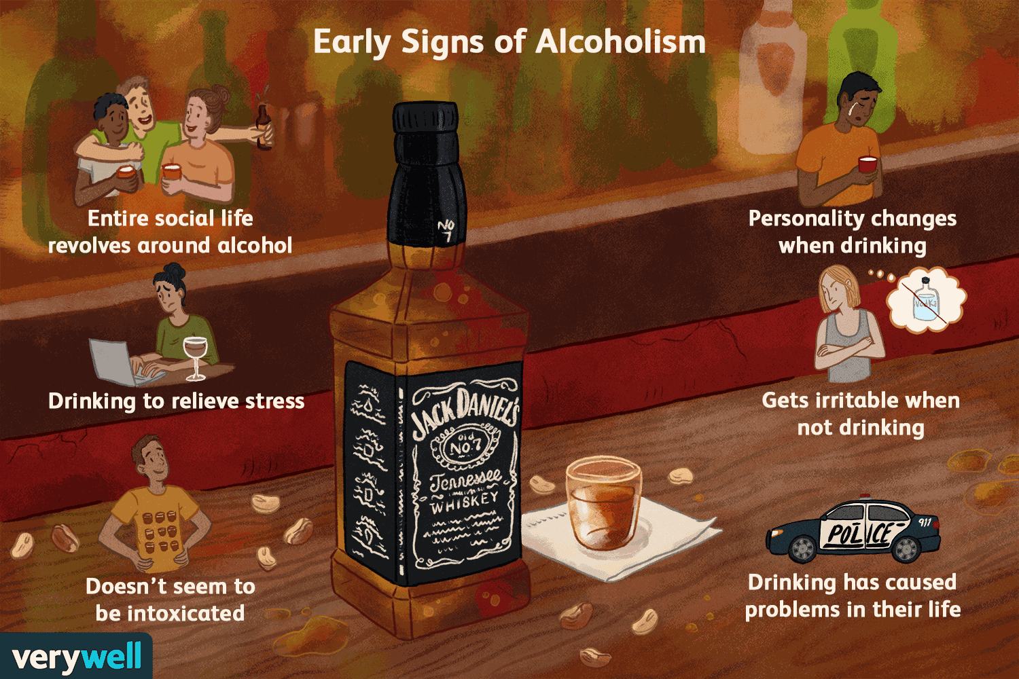
Summary and Recommendation
Male partners who take a lot of alcohol have been found to be abusive to their female partners.
Alcoholism is linked to both personal as well as social issues.
Alcoholism affects human relationship.
The FDA approved medications for alcoholism.
Notes:
Alcoholism has been found to make the male partners abusive in a relationship. It has also been linked to promoting both personal as well as social issues. Alcoholims is associated with effects of health as well as exposing the abusers to danger, for instance, in the case a person drinks and drives (Ashford, et al., 2018). However, the govern through the FDA has been making efforts to help curb the issue of alcoholism through medications.

Slide 7
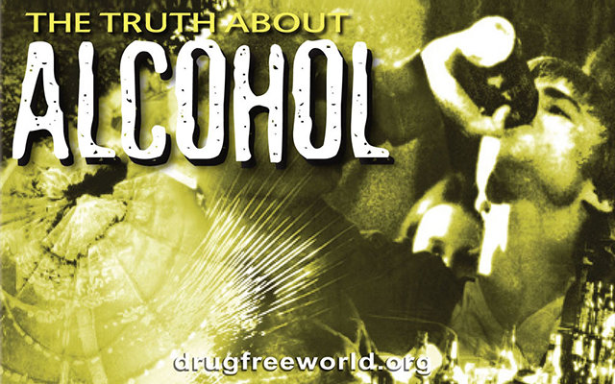
References
Ashford, J. B., LeCroy, C. W., & Williams, L. R. (2018). Human behavior in the social environment: A multidimensional perspective.
Substance Abuse and Mental Health Services Administration (US); Office of the Surgeon General (US). Facing Addiction in America: The Surgeon General's Report on Alcohol, Drugs, and Health [Internet]. Washington (DC): US Department of Health and Human Services; 2016 Nov. CHAPTER 7, VISION FOR THE FUTURE: A PUBLIC HEALTH APPROACH. Available from: https://www.ncbi.nlm.nih.gov/books/NBK424861/
Roberts, L. W., Roberts, L. W., & American Psychiatric Association Publishing. (2016). A clinical guide to psychiatric ethics. Arlington, VA: American Psychiatric Association Publishing.

